Slide 1
Narnarayan Shastri Institute of Technology, Jetalpur Electronics & Communication Dept A presentation on Overview of DC Circuit
Prepared By
Gandhi Paneri
Parihar Karuna
Bhalala Jigisha
Guided By
Shailesh Beldar
Assistant Prof.
NSIT, Jetalpur

Slide 2
Contents
Basics of DC Circuit.
Series Connection
Parallel Connection.
Ohm’s Law.
Kirchhoff’s first Law.
Kirchhoff’s Second Law.

Slide 3
Basics of DC Circuit
Direct current (DC) is the unidirectional flow of electric charge.
A Closed path in which direct current flows is called is called DC circuit.
Direct current is produced by sources such as batteries or solar cells
Direct current may flow in a conductor such as a wire, but can also flow through semiconductors, insulators.

Slide 4
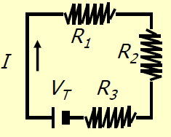
Conti…..
The circuit show in the fig is called DC circuit.
Here three resistors R1, R2, and R3 are connected in series and there is only one way for the flow of current or direction of current is unidirectional.

Slide 5
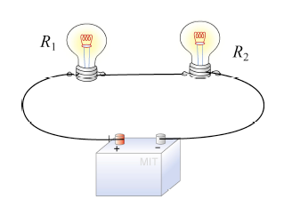
Continue..
Practical Example of DC Circuit.
Here two lamp(load) are connected in series and only one way for the flow of current.

Slide 6
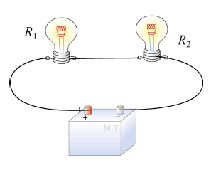
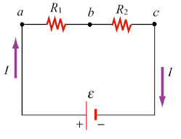
Series connection
When Resistor are connected end to end So that they form only one path for the flow of current then the resistor are said to be connected in series.

Slide 7
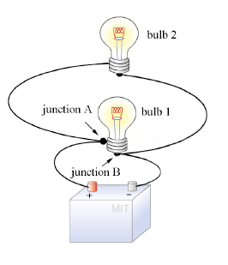
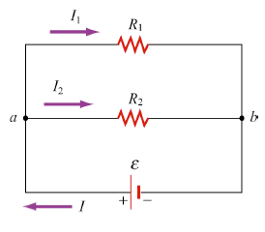
Parallel Connection
When number of Resistor are connected in such a way one end of each of them joined to common point(A) and the other end being joined to another common point(B) then the Resistor are said to be connected in parallel.

Slide 8
Laws used for DC Circuit
Laws used for solving DC circuit
1) Ohm’s Law
2) Kirchhoff's Law

Slide 9
Ohm’s Law
It states that the current flowing between any two points of a conductor is directly proportional to the potential difference across them, provided the physical condition do not change.
I α V
V/I = Constant.
V/I = R

Slide 10
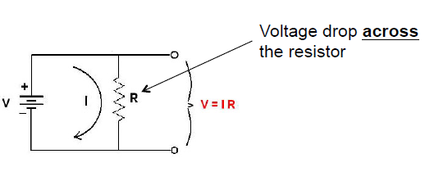
Cont..

Slide 11
Limitation of Ohm’s Law
It does not apply to all non-metallic conductors.
It also does not apply to non-linear devices such as zener diode.
It is true for metal conductors at constant temperature. If the temperature change law is not applicable.

Slide 12
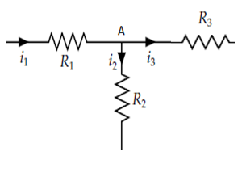
Kirchhoff's first Laws
It is also known as Kirchhoff's current law or Kirchhoff's point law.
It states that all the currents terminating at a point is zero at any instant of time.

Slide 13
Explanation:
An algebraic sum is one in which the sign of quality(+ or -) is taken in to account.
If the current entering at a node are assigned positive sign, then the current leaving at a node will be assigned negative sign.
Consider the fig of above slide.
In this fig three resistor R1, R2 and R3 are connected to a node A.

Slide 14
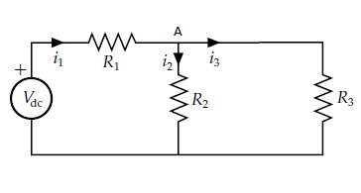
Consider a network as shown in fig, current i₁ entering at node and current i₂ and i₃ leaving the node A.
Applying KCL at node A.
(i₁)+(-i₂)+(-i₃)=0
I₁=i₂+i₃
sum of incoming current = sum of outgoing currents

Slide 15
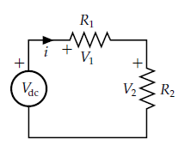
Kirchhoff's Second Laws
It is also known as Kirchhoff's voltage law or Kirchhoff's mesh law.
It states that at any instant of time, the algebraic sum of all the voltages around any closed loop of a electric network is zero

Slide 16
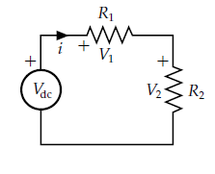
Explanation
Kirchhoff’s voltage law is a statement of the law of conservation of energy.
As show in fig two resistor are connected R1, R2 are connected to Vdc.

Slide 17
Here applying the KVL,
V_{dc} = V₁ +V₂
V_{dc} = IR₁ + IR₂
A battery V_{dc} is applying energy to two resistances connected in series
IR₁ and IR₂ are voltage drop across R1 and R2 respectively.

Slide 18
Thank you…
Question???

